Slide 1

Chem 322
Selected Topic of Inorganic Chemistry
Dr. Md. Arzu Miah
Post Doc. ( KAIST, S. Korea), PhD (Veinna, Austria), M.Sc & B.Sc in Chemistry (JU)
Professor
Department of Chemistry
Jahangirnagar University
Savar, Dhaka-1342
Cell: 01732150725
mamiah@juniv.edu

Slide 2
Chapter-3
Bonding in Electron Deficient and
Non-stoichiometric Compounds

Slide 3


Electron Deficient Compound
Electron-deficient compounds are compounds in which an element has an incomplete octet.
H, Be, and B, often have fewer than eight electrons in Lewis structures.
For example, BF₃ is an electron-deficient compound.

Slide 4
Non-stoichiometric Compounds
Non-stoichiometric compounds are chemical compounds with an elemental composition that cannot be represented by a ratio of well-defined natural numbers, and therefore violate the law of definite proportions.
Non-stoichiometric compounds are also known as berthollides (as opposed to the stoichiometric compounds or daltonides).

Slide 5
Example
Although wüstite (ferrous oxide) has an ideal (stoichiometric) formula FeO, the actual stoichiometry is closer to Fe_{0.95}O.
The non-stoichiometry occurs because of the ease of oxidation of Fe²⁺ to Fe³⁺
Thus for every three "missing" Fe²⁺ ions, the crystal contains two Fe³⁺ ions to balance the charge.
Thus, the formula for wüstite is written as Fe_{1-x}O, where x is a small number (0.05 in the previous example) representing the deviation from the "ideal" formula.

Slide 6
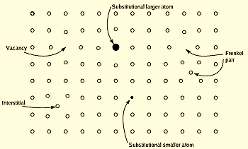
Crystallographic defects can cause solids to be non-stoichiometric

Slide 7
Alfred Stock established borane Chemistry
Boron Hydride or Borane
The compounds of Boron with Hydrogen is called
Boron hydride or Borane.
B + H = Borane
Two Classes:
B_{n}H_{(n+4)-} Nido - borane
B_{n}H_{(n+6)-} Arachno -borane

Slide 8
Examples
Nido
B₂H₆ - Diborane
B5H9 - Pentaborane -9
B₆H₁₀ ₋ Hexaborane-10
B₈H₁₂ ₋ Octaborane- 12
B₁₀H₁₄ - Decaborane
Arachno
B₄H₁₀ - Tetraborane
B₅H₁₁ – Pentaborane -11
B₆H₁₂- Hexaborane-12
B₈H₁₄ –Octaborane-14
B₉H₁₅- Nonaborane
  B₂H₆ ⇌ 2BH₃
  BH₃ +B₂H₆ → B₃H₇ +H₂ (rate determining step)
  BH₃ + B₃H₇ ⇌ B₄H₁₀
  B₂H₆ + B₃H₇ → BH₃ + B₄H₁₀
        ⇌ B₅H₁₁ + H₂
B₂H₆, is a colorless gas at room temperature. It is believed to be in equilibrium with borane, BH₃, according to the equation,
2BH₃ B₂H₆

Slide 9
The Hydride of Boron/ Diborane ( B₂H₆)
Synthesis:
4BCl₃ + 3LiAlH₄ → 2B₂H₆ + 3LiAlCl₄
4BF3 + 3NaBH₄ → 2 B₂H₆ + 3NaBF₄
2NaBH₄ + I₂ → 2NaI + B₂H₆ + H₂
8 BF₃ + 6LiH → B₂H₆ + 6LiBF₄
BF₃ + 6NaH B₂H₆ + 6NaF
(Industrial Method)

Slide 10
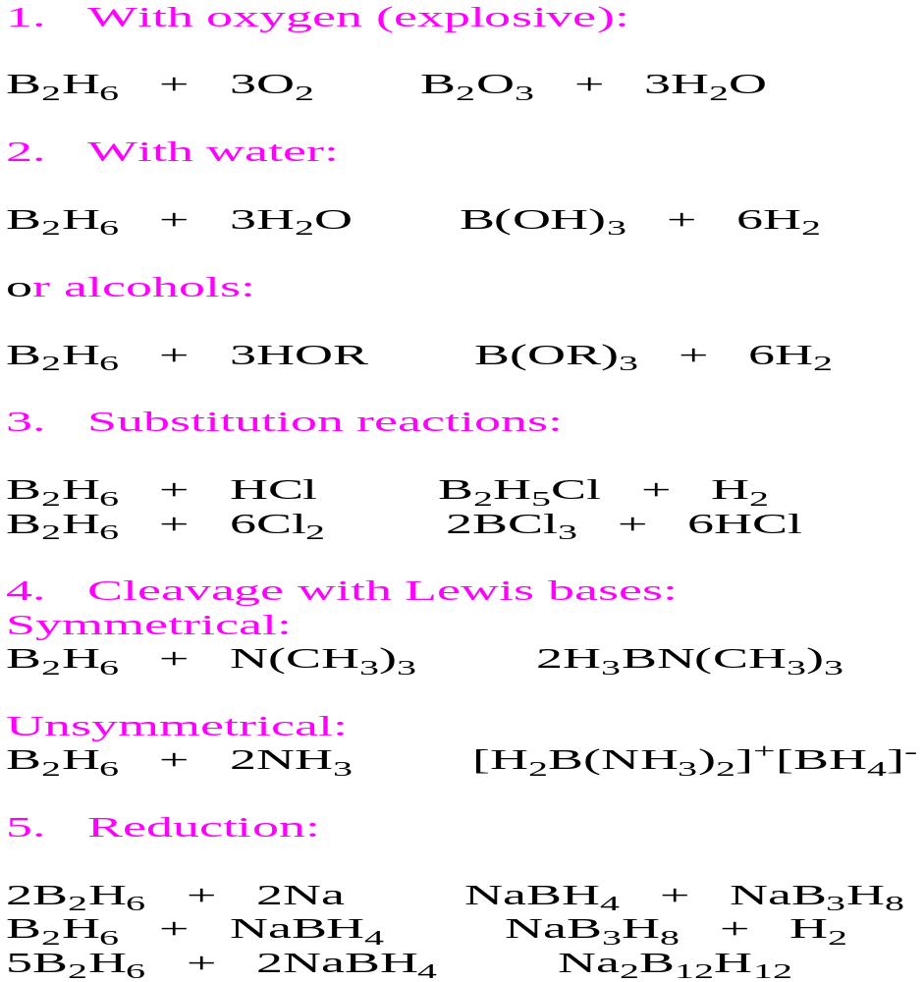
Reaction of B₂H₆

Slide 11
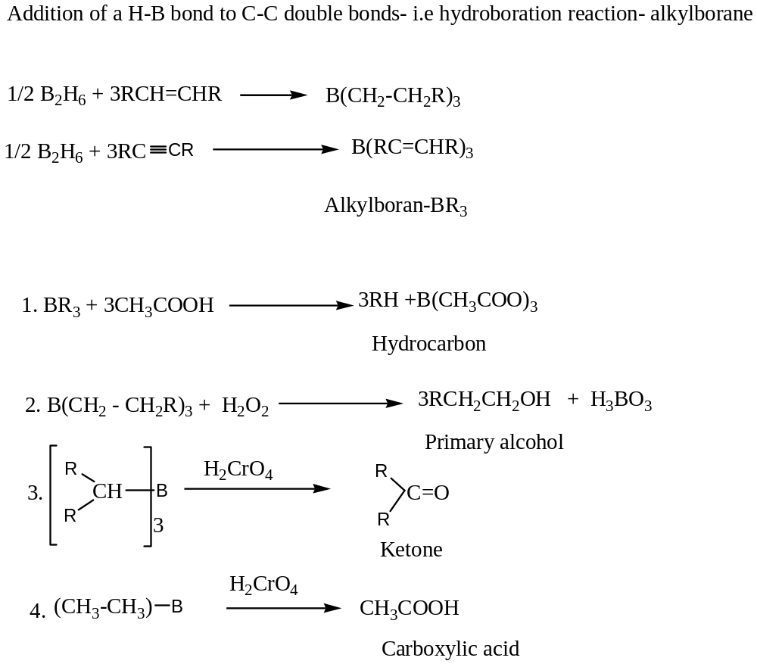

Slide 12
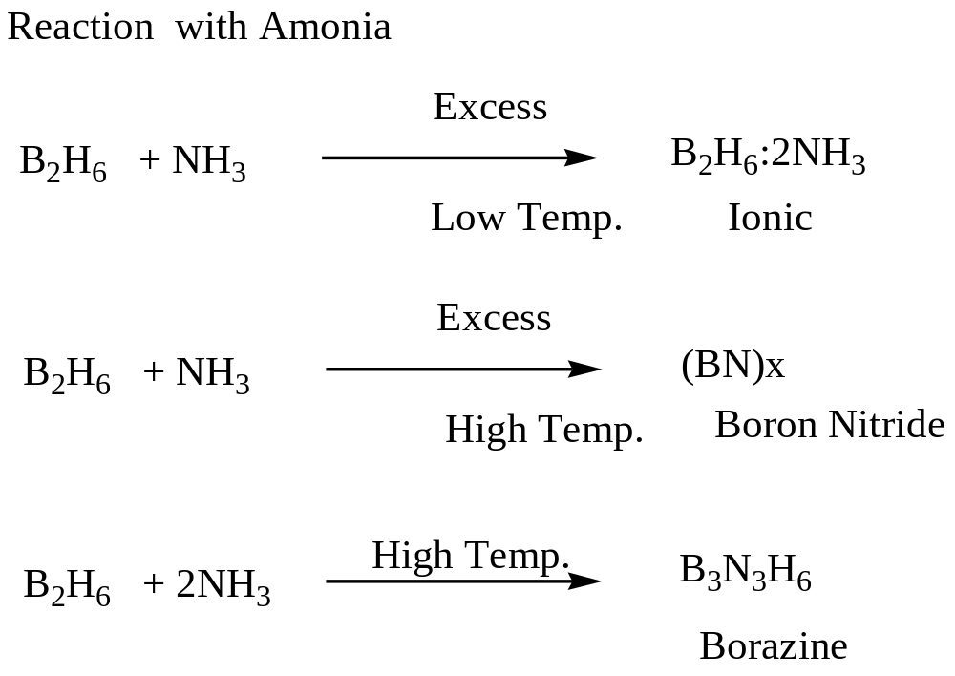

Slide 13
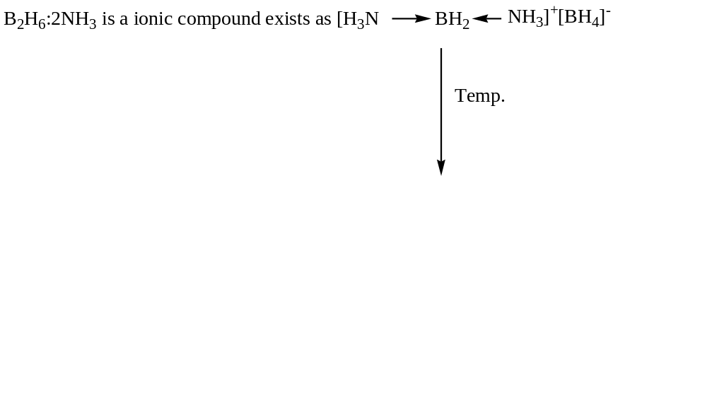
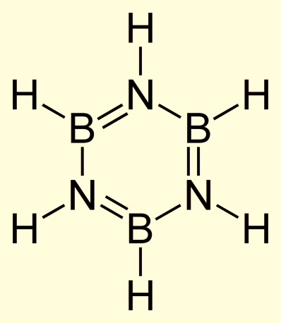
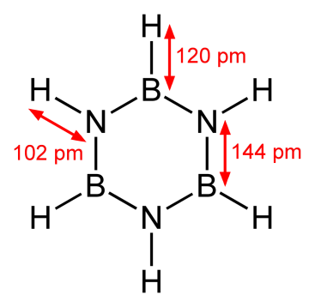
Borazine

Slide 14
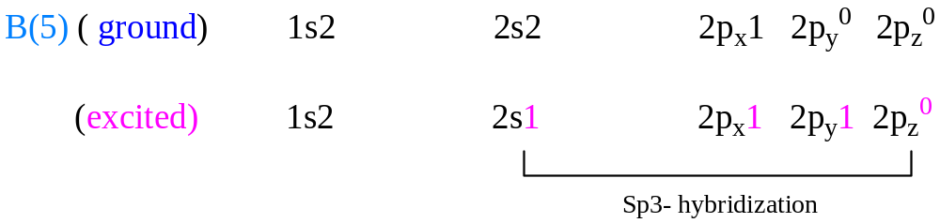
Bonding in Diborane, B₂H₆
The hybridization B(5) is sp³

Slide 15
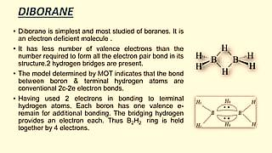

Slide 16
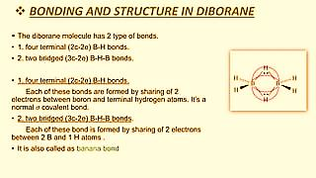

Slide 17
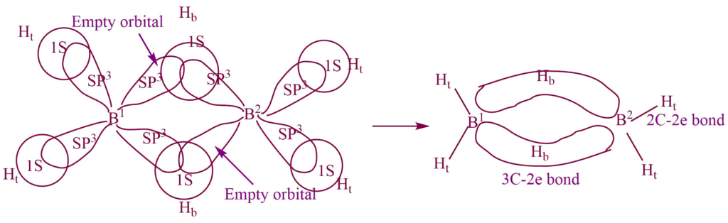
3C- 2e Bond
An electron-deficient chemical bond involves three atoms sharing two electrons. Three atomic orbitals combine to form three molecular orbitals, i.e., one bonding, one nonbonding, and one antibonding.
Many common bonds of this type have the bonding orbital shifted toward two of three atoms rather than being spread evenly. E.g., B₂H₆

Slide 18
Formation of 3C- 2e bond in diborane
Electron diffraction and Ir study shows that B₂H₆ has hydrogen – bridged structure as:
There are insufficient electrons, so each boron atom bonded to the two terminal hydrogen atoms (H_{t}) and the other two with a common hydrogen bridge (H_{b})and forms a banana bond called the 3c -2e bond.
Valence shell configuration of the Boron atom,
Ground state: 1S², 2S², 2P_{X}¹, 2P_{Y}⁰, 2P_{Z}⁰,
Excited state: 1S², 2S¹, 2P_{X}¹, 2P_{Y}¹, 2P_{Z}⁰,
The four atomic orbitals hybridize together to give four SP³ hybrid orbitals in which one is empty and the remaining three are singly filled. Hence each boron atom uses SP³ hybrid orbitals.

Slide 19
One singly filled SP³ hybrid orbital on the B¹ atom and one empty SP³ hybrid orbital on the B² atom and a singly filled 1S orbital on one H_{b} atom overlap together and form one bridging 3c -2e bond.
Similarly, one empty SP³ hybrid orbital on the B¹ atom and one singly filled SP³ hybrid orbital on the B² atom, and a singly filled 1S orbital on another H_{b} atom overlap together and form another bridging 3c -2e bond. The remaining two singly filled SP³ hybrid orbital of each B- atom overlap with the singly filled SP³ 1S orbital of the H_{t} atom to form a normal 2c- 2e bond.

Slide 20
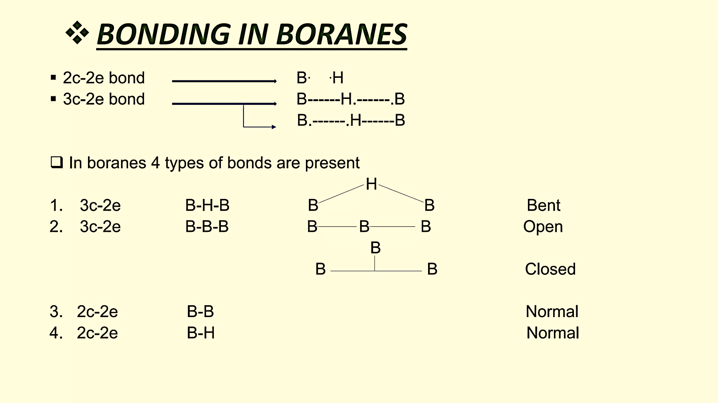

Slide 21
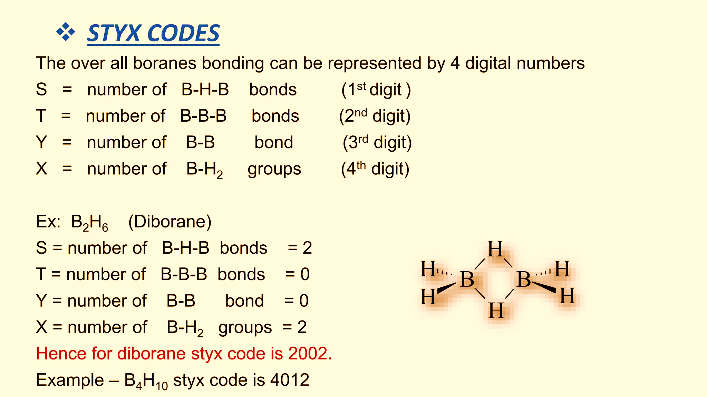

Slide 22
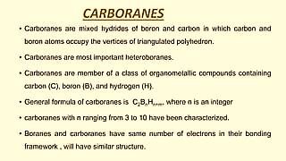

Slide 23
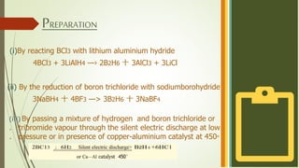

Slide 24
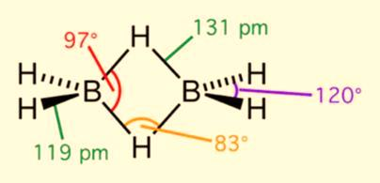
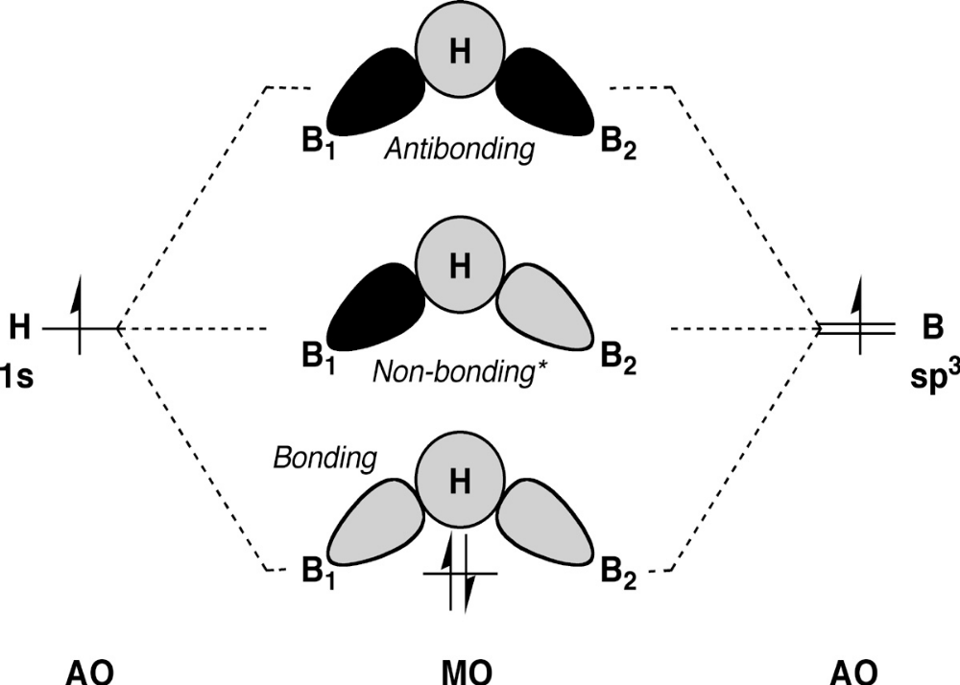
According to VBT
According to MOT

Slide 25
Three-center two-electron bond
A three-center two-electron bond is an electron deficient chemical bond where three atoms share two electrons.
The combination of three atomic orbitals form three molecular orbitals: one bonding, one non-bonding, and one anti-bonding.
The two electrons go into the bonding orbital, resulting in a net bonding effect and constituting a chemical bond among all three atoms.
In many common bonds of this type, the bonding orbital is shifted towards two of the three atoms instead of being spread equally among all three.
When visualised in 3D, it looks like a banana, and hence a 3-center-2-electron bond is often called a banana bond.

Slide 26
The MO scheme for one of the B–H–B bridging three center two electron bonds. *This picture is still a simplification of the actual MO scheme. The non-bonding orbital is actually of slightly lower energy than shown and so has slight bonding character. This arises from the fact that the orbitals involved in the terminal B–H bonding have the correct symmetry to overlap with the bridging bond orbitals, resulting in a stabilization of the ‘nonbonding’ orbital.

Slide 27
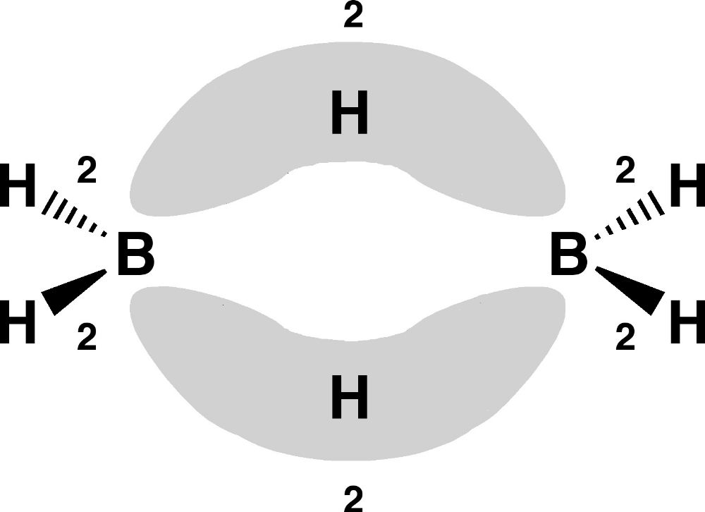
Banana Bond

Slide 28
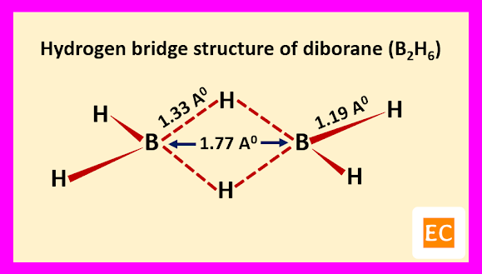

Slide 29
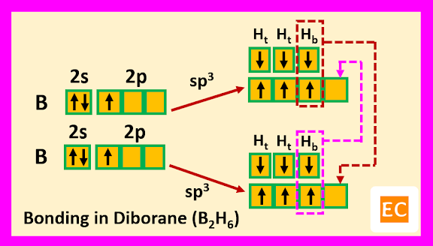

Slide 30
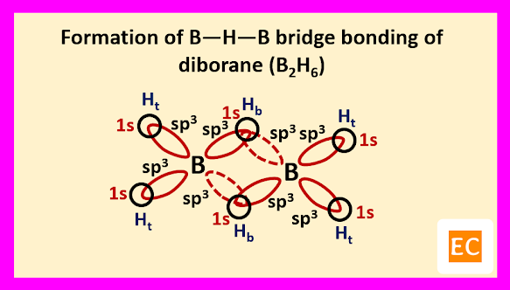

Slide 31
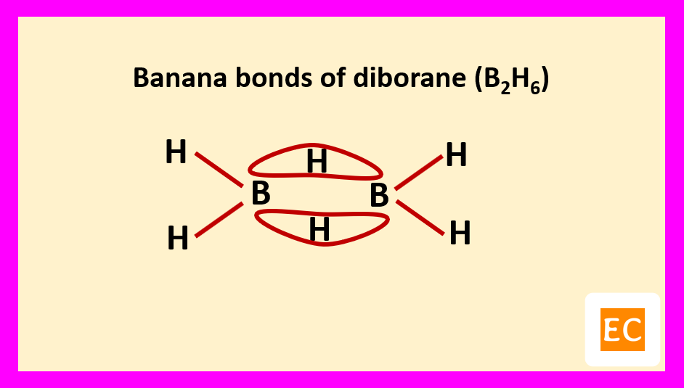

Slide 32
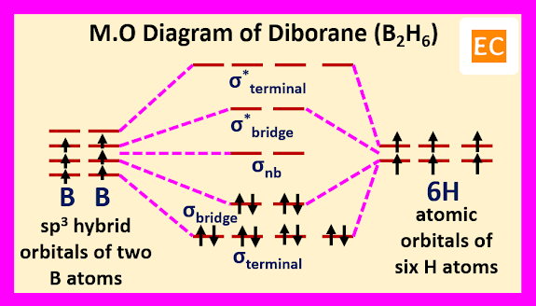

Slide 33

Five Bonding Elements in Higher Borane
a b c d e
(a) Terminal 2c-2e Boron-Hydrogen bond
(b) 2c-2e boron-born bond
(c) 3c-2e boron-hydrogen-boron bridge bond
(d) Closed 3c-2e boron-boron-boron bond
(e) Open 3c-2e boron-boron-boron bond

Slide 34
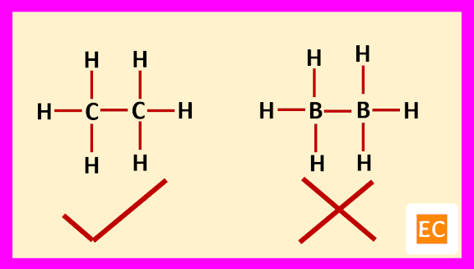
Structure and Bonding of Diborane (B₂H₆)
Boron is an electron deficient element. Due to its electron deficient character, the trivalent boron leads to dimerization to form diborane (B₂H₆). If we assumed that, the structure of diborane (B₂H₆) is similar to single bond structure of ethane (C₂H₆), then this assumption is rejected because single bond structure of ethane (C₂H₆) contains 14 electrons [(4+4 = 8 electrons from two carbon atoms) and (1x6 = 6 electrons from six Hydrogen atoms)] but in diborane there are only 12 electrons [(3+3 = 6 electrons from two boron atoms) and (1x6 = 6 electrons from six hydrogen atoms)].

Slide 35
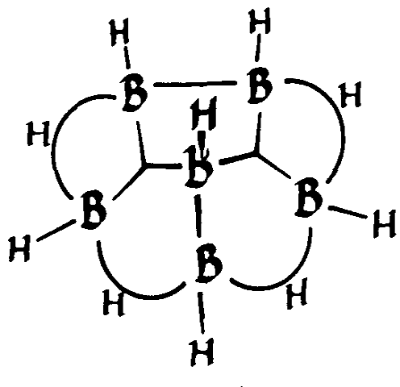
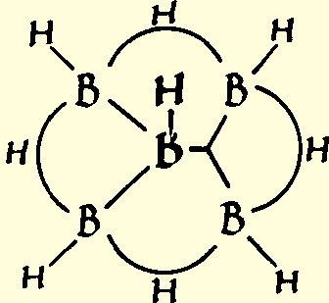
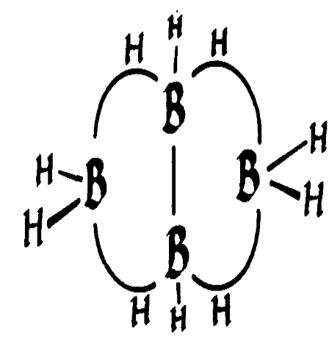
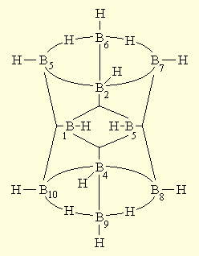
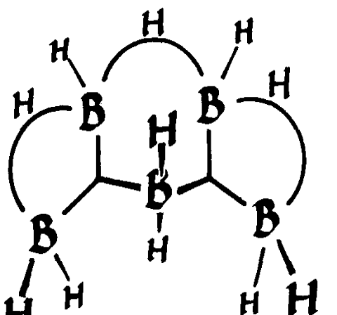
B₆H10
B5H9
B4H10
B5H11
B₁₀H₁₄

Slide 36
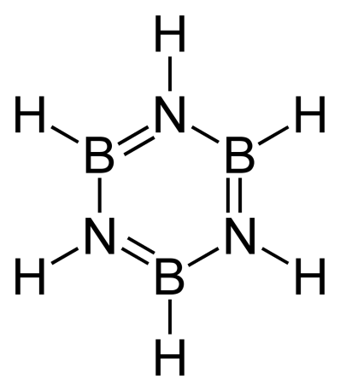

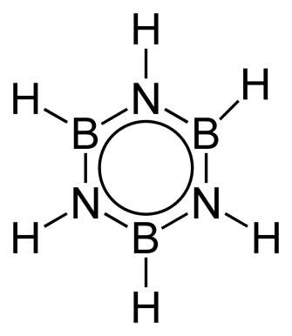
Borazine
The molecules are flat, and rotation about the B—N bond is restricted, therefore the left-hand structure must be is a significant contributor. It is perhaps not correct to represent them as canonical structures since the geometries would be so different.

Slide 37
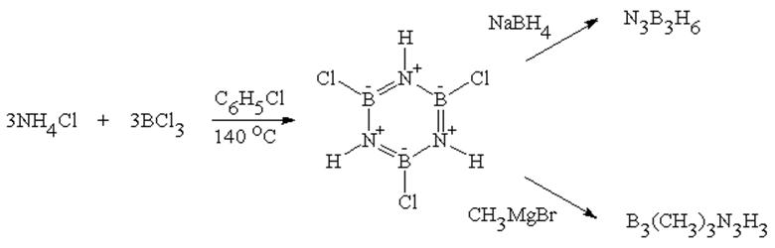
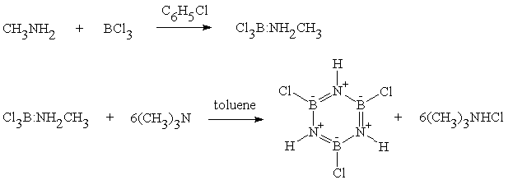

Slide 38
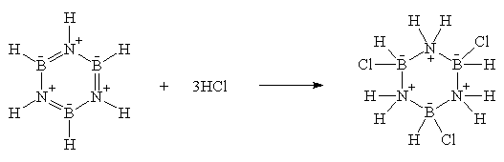
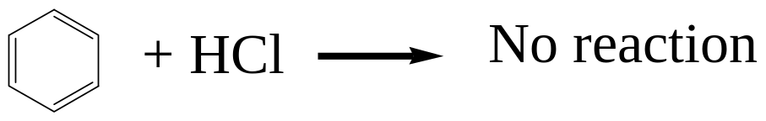
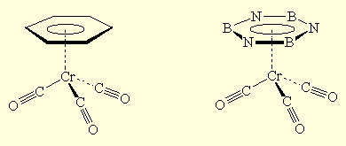
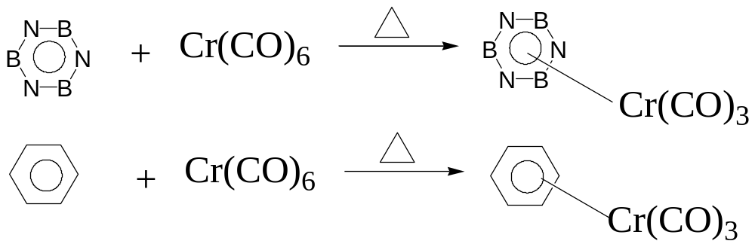
Unlike benzene, borazine undergoes addition reactions:
Like benzene, borazine can form π-complexes with transition metals:

Slide 39
What are the Similarities Between Borazine and Benzene?
Both are cyclic structures.
Also, both, borazine and benzene, have a six-membered ring.
Moreover, both have equal bond lengths between the atoms of the ring.
Furthermore, both are colourless liquids at room temperature.
Both are isoelectronic as well.

Slide 40
What is the Difference Between Borazine and Benzene?
Borazine is an inorganic compound having the chemical formula B₃H₆N₃
whereas Benzene is an organic compound having the chemical formula C₆H₆.
Therefore, the key difference between borazine and benzene is that the borazine contains three boron atoms and three nitrogen atoms in the ring structure
whereas benzene contains six carbon atoms in the ring structure. In borazine, the boron and nitrogen atoms are in an alternating pattern. As a result, the borazine molecule is not a perfect hexagon, but benzene has only carbon atoms in the ring. Thus, it can form a perfect hexagon. Hence, we can consider this as another difference between borazine and benzene.
Above all, a significant difference between borazine and benzene is that the borazine is a synthetic compound whereas the benzene naturally occurs in crude oil as a major constituent. Also, we can identify a difference between borazine and benzene based on their reactivity as well. Comparatively, borazine is more reactive than benzene.

Slide 41
Comparsion of Borazine and Benzene
Definition | Borazine is an inorganic compound having the chemical formula B₃H₆N₃ | Benzene is an organic compound having the chemical formula C₆H₆
Chemical Nature | Inorganic | Organic
Ring Structure | Alternating Boron and Nitrogen atoms | Only carbon atoms
Reactivity | Comparatively more reactive | Comparatively less reactive
Hexagonal Structure | Not a perfect hexagon | A perfect hexagon
Occurrence | Synthetic | Naturally Occurs in Crude oil

Slide 42
The Tetrahydroborate Ion (BH₄⁻)
NaBH₄ is stable in dry air and alkaline aqueous solution. (It will react with water initially but the reaction stops as the concentration of the hydrolysis product, sodium borate, builds up.)
LiBH₄ is similar to NaBH₄ but more sensitive to water.
Al(BH₄)₃ is liquid which explodes with air or water. It probably has pairs of hydrogen bridges like diborane.
Zr(BH₄)₄ is a molecular solid with three bridging hydrogens connecting each boron to the zirconium.

Slide 43
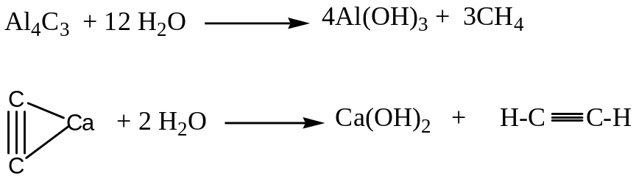
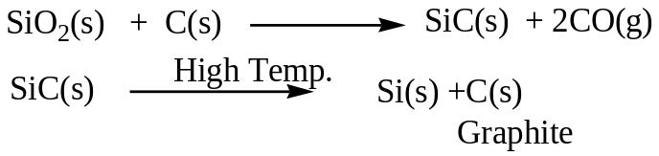
Carbide
The binary compound of C with M is called carbide
Example : Al4C3, CaC2
Types of Carbide :
Ionic or Salt-like carbide : C⁴⁻, ^{C}₂ ²⁻
Interstitial Carbide: Transition metal forms this carbide
Structure: Closed-packed, Hard, Electric Conductor, High m.p.
WC, Fe3C, Mn3C, Ni3C- They are hydrolysed by Acids.
Covalent Carbide: SiC, B4C – Very Complex Structure, Very Hard,

Slide 44
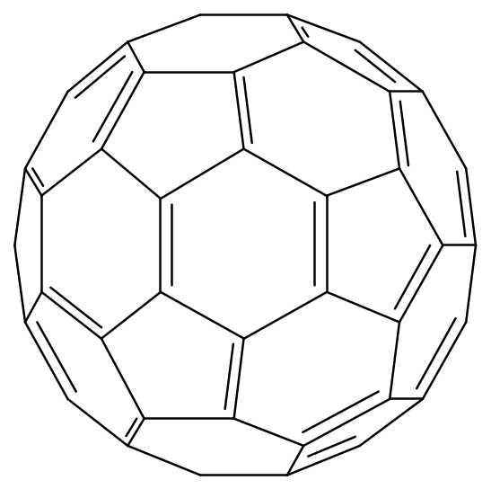
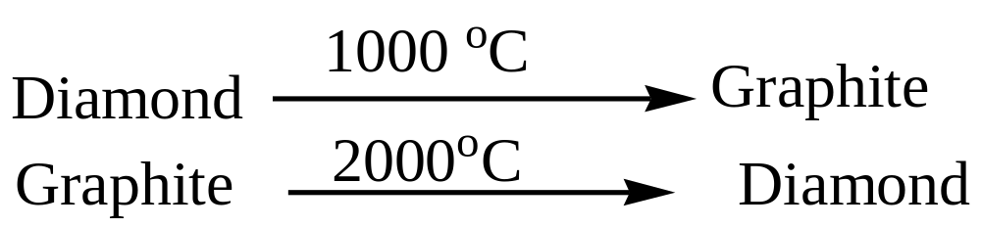
Diamond Vs Graphite
Two crystal form of Carbon, Diamond and Graphite,
The another form of Carbon- Fullerene- C_{6o}

Slide 45
Comparison Between Diamond and Graphite
Diamond | Graphite
1. Tetrahedral Arrangement of C Angle 109º | 1. Square Planer arrangement of C Angle- 120º
2. Three dimensional network | 2. Layered structure (3.4 Ǻ) separation
3. Sp³ hybridization | 3. Sp² hybridization
4.Non-conductor of electricity | 4.Good conductor of electricity
5. No free electron | 5. Free electron moves to a particular layer
6. Very hard | 6. Soft and malleable
7. Density – 3.51 g/cm³ | 7. Density – 2.22 g/cm³

Slide 46
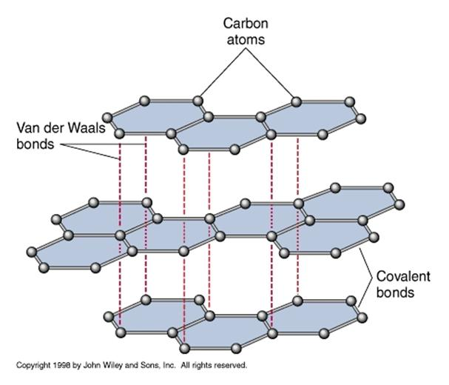

Slide 47
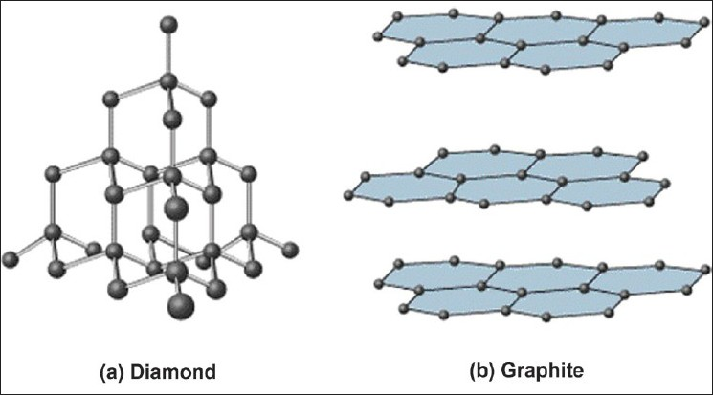

Slide 48
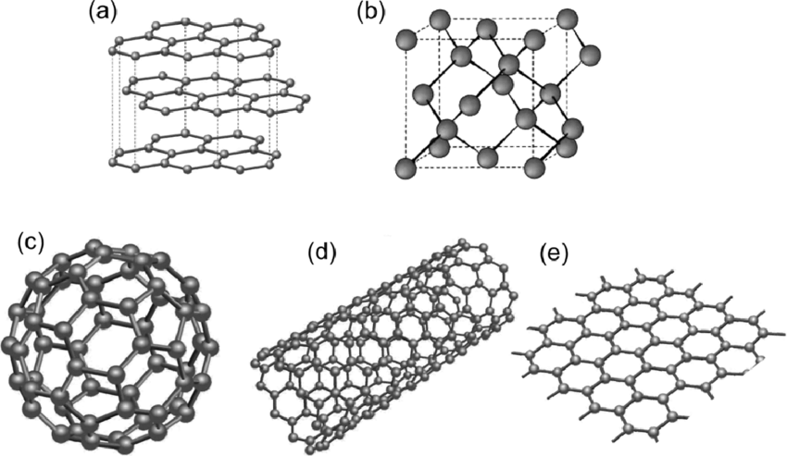

Slide 49
THANK YOU

